Slide 1
Lecture 2
Understanding Value Education

Slide 2
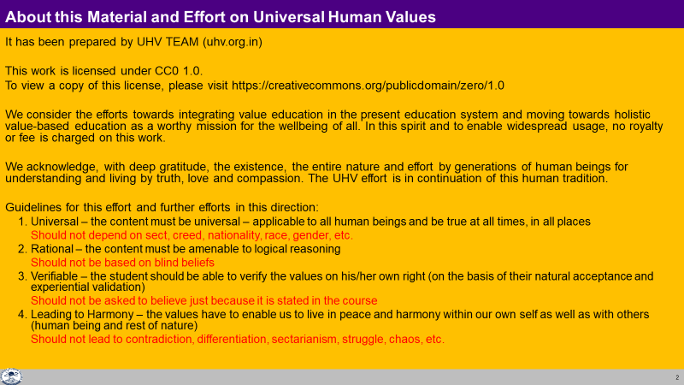

Slide 3
Value
Value of a unit is its participation in the larger order
e.g. The value of food, e.g. wheat (unit) vis-à-vis human being (larger order) is its participation in providing nutrition to the Body
Participation = value
The context is always the larger order
Value of a unit is definite
e.g. a kg of wheat provides the same nutrition (it does not change with time, place or person)
[Of course, there may be wheat of different types, qualities etc., so, we are talking about a specific type of wheat]
The value of a unit is also referred to as its role
Thus, the role of wheat is to provide nutrition to the Body

Slide 4
Value
Value of a unit is its participation in the larger order
e.g. The value of a piece of chalk is its participation in the classroom
What is valuable
  The chalk writes on the blackboard in the classroom?
  or
  The chalk scratches the blackboard in the classroom?
What is valuable = value
The context is always the larger order
Value of a unit is definite
The value of a unit is also referred to as its role
Thus, the role of chalk is to write on the blackboard

Slide 5
Human Value
Value / role of a human being is its participation in the larger order
  E.g. My participation in the family defines my value in the family
  For order in my family, what is valuable?
  Behaviour with feeling of respect or feeling of disrespect?
  I feel happy when I have a feeling of respect
  The other feels happy when I express respect to him/her
Living in accordance with human values with human being leads to mutual happiness, i.e.
  Happiness in me
  Happiness of the other human being
Living in accordance with human values with rest of nature leads to mutual prosperity
  Feeling of prosperity in me
  The preservation of the rest of nature, i.e. its enrichment, protection and right utilisation

Slide 6
Understanding Human Values
In nature, every unit participates with every other unit in a mutually fulfilling manner
e.g. air nurtures plants and plants enrich air
Except for human being (who does not understand human values)
For a human being to live with human values,
s(he) has to understand human values
        e.g. for a human being to live with a feeling of respect s(he) has to understand the feeling of respect
To live with happiness, human beings need to understand human values
They need to understand their participation
They need to understand their role

Slide 7
Human Values, Role of Human Being in the Larger Order
Individual
I have a role within myself
(eg. ensuring happiness in the self and health in the body)
Family
I have a role in my family
(eg. ensuring feeling of relationship and prosperity)
Society
I have a role in the society
(eg. to participate in social systems for ensuring justice, peace and harmony)
Nature/Existence
I have a role in nature/existence
(eg. mutual fulfilment with rest of nature)

Slide 8
Deciding Our Values
Do you want to be able to decide on your own right?
or
Do you want someone else to decide for you?
(this someone may be a group of people, it may be the society or the education system, etc.)
If you are not able to decide on your own right then:
  Someone else is deciding what is valuable and what is not valuable for you
  Unconsciously you may keep accepting those things as values
  You get busy with analyzing how to implement them, how to realize them, materialize them

Slide 9
Values Decided by the Other
e.g. In a professional college, many first-year students start to use foul language within a very short time
They begin to assume that this sort of language is one of the indicators of their freedom, of their own progress to adulthood… and they may adopt it as a new value
Similarly, with sleeping late and getting up late… and so many things
Did they decide it for themselves?
Did it just happen “unconsciously”, without being aware of it?
Is it worth for them? Is it fulfilling for them?
Is it fulfilling for others (like their family members)?
So, if we are unable to decide on our own right, we are programmed by the other; our values are decided by someone else…

Slide 10
Deciding Human Values on Our Own Right
Would we decide on the basis of whatever we like, whatever we believe?
  If we decide in this manner, values will be different for different people
Or is there some definite, existential basis, something we can understand, something we can be assured about, something that ensures mutual fulfillment in living?
  If this is the case, then there is a possibility that human values are universal, they are the same for all of us
Value education is about exploring this possibility

Slide 11
Should Education help Students to Understand Values (Develop Holistically)?
Understanding What to do, Values Value Education
Learning How to do, Skills guided by Values Skill Development
Doing Guided by Values Practice
The problems around you are more due to lack of skills?
or more due to lack of values?
Are both, values and skills, required?
Both are required; Values and skills are complementary to each other
If both are required, then what is the priority?
Values (what to do) first, then skills (how to do), but both are required
What is the state in present-day education?
Education has become skill-biased
(there is a need to make appropriate changes)

Slide 12
Guidelines for Value Education
Universal
The content needs to be universal – applicable to all human beings and be true at all times, all places
It should not depend on sect, creed, nationality, race, gender, etc.
Rational
It must be amenable to logical reasoning
It should not be based on blind beliefs
Verifiable
The student should be able to verify the values on one’s own right
Should not be asked to believe just because it is stated in the course
Leading to Harmony
Values have to enable us to live in peace and harmony within our own self as well as with others (human being and rest of nature)

Slide 13
Guideline 1. Universal
It is universally applicable to all human beings and be true at all times and all places
It is about the basic principles of human existence which are universal. And if it is universal then it is not dependent on any sect, caste, creed, nationality, gender etc.
Eg. Living with a feeling of relationship is naturally acceptable to all human beings – it is universal
Q: What do you think Value Education has to be universal or sectarian? It has to be dependent on time, space and individual or independent of time, space and individual (i.e. apply equally to all of them)?
If it is universal then it is secular and it is more than that. When you say secular, it is a negation. Universal is more than secular. One of the interpretations of secularism is that we not talk about religion or sex. What has happened in the name of secularism is that we have stopped talking about human beings. So, secularism is basically a negation, not an assertion. When you say universal, it is an assertion.

Slide 14
Guideline 2. Rational
It is a set of proposals about reality, not a set of negations
It is amenable to reasoning
It is not based on whims, fancies, dogmas or blind beliefs
It is not a set of sermons
It is not a set of do’s and don’t
It is not antirational
It is not illogical
it can be communicated clearly
It can be questioned
it can be verified
It can be understood

Slide 15
Guideline 3. Verifiable
We want to verify these values ourselves, i.e. we don’t want to assume something just because something is stated, rather, each one of us will want to verify these to find out whether they are true for us
It has to be naturally acceptable, and
experientially verifiable in terms of mutual fulfilment in my behaviour and work
    Behaviour with human beings leads to mutual happiness
    Work with rest of nature leads to mutual prosperity
If it is naturally acceptable, it leads to commitment to live in that manner without being forced in any way or conditioned by another person
Every individual needs to be able to verify these values oneself

Slide 16
Guideline 4. Leading to Harmony
Finally, value education must be able to enable us to be in harmony within and live in harmony with others in the complete expanse of our being, of our living
As an individual, it needs to take care of all the dimensions of our individual existence – thought, behaviour, work and the realization
Also it must cover all levels starting from individual to family to society and to nature/existence
Hence, when we live on the basis of these values, we start understanding that it will lead to harmony in us and harmony in our interactions with other humans and the rest of nature. That is, it leads to human conduct

Slide 17
Content of Value Education
Holistic, All Encompassing
Covers all levels of living:
    Individual (human being)
    Family
    Society
    Nature/Existence
Eg. As a Family, Society – we want Fearlessness / Trust
NOT fear (due to mistrust / opposition)

Slide 18
Four Dimensions of a Human Being
1. Understanding
Proposal
2. Thought
3. Behaviour
4. Work/Participation in the larger order

Slide 19
Content of Value Education
Holistic, All Encompassing
Covers all levels of living:
    Individual (human being)
    Family
    Society
    Nature/Existence
Eg. As a Family, Society – we want Fearlessness / Trust
NOT fear (mistrust / opposition)
Covers all dimensions of being, as an Individual:
    Understanding/Realization
    Thought
    Behaviour
    Work/Participation in larger order
Eg. In Thought – we want to have clarity (a state of resolution, solution)
NOT confusion (a state of problem)

Slide 20
Process of Value Education
Universal
The content needs to be universal – applicable to all human beings and be true at all times, all places
It should not depend on sect, creed, nationality, race, gender, etc.
Rational
It must be amenable to logical reasoning… should be able to question
It should not be based on blind beliefs
Verifiable
The student should be able to verify the values on one’s own right
Should not be asked to believe just because it is stated in the course
Leading to Harmony
Values have to enable us to live in peace and harmony within our own self as well as with others (human being and rest of nature)

Slide 21
Process of Value Education
Whatever is said is a Proposal
Verify it on Your Own Right – on the basis of our Natural Acceptance
(Do not assume it to be true or false)
It is a process of Dialogue
A dialogue between me and you, to start with
It soon becomes a dialogue within your own self
between what you are and what you really want to be (your natural acceptance)
The purpose of this course is to initiate this internal dialogue,
to help you to be self-referential, self-confident
Is this process naturally acceptable to you?
Is the purpose of this course valuable for you?
More

Slide 22
Process of Self-verification
Whatever is stated is a Proposal
Verify it on your own right
(Do not assume it to be true/ false)
Proposal
1
2
Verify
on the basis
Of
your
Natural
Acceptance
Experiential Validation
Live according to it
2a
2b
Behaviour with
Human Beings
Work with
Rest of Nature
Mutual Happiness
Mutual Prosperity
RIGHT
UNDERSTANDING

Slide 23
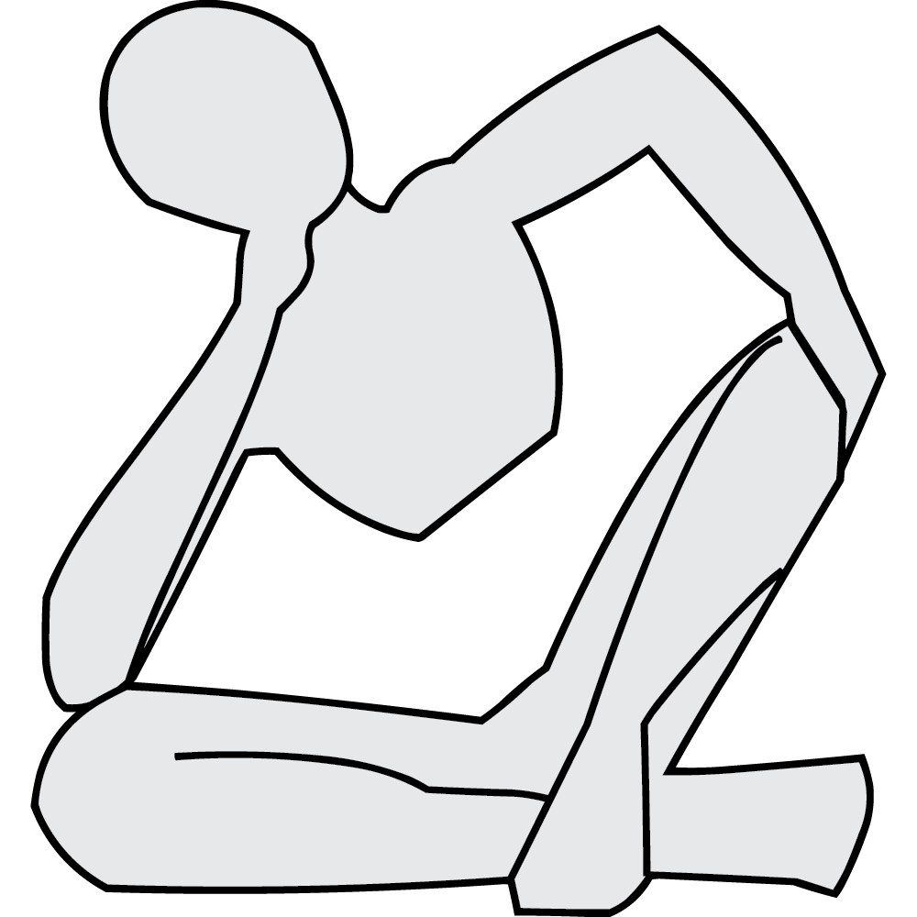
In this course, we will explore…
What is my role (value) in the family?
What is my role (value) in the society?
What is my role (value) with my Body?
Who am I?
What is my purpose? What is my role (value) with myself?
What is my role (value) in Nature/existence?

Slide 24
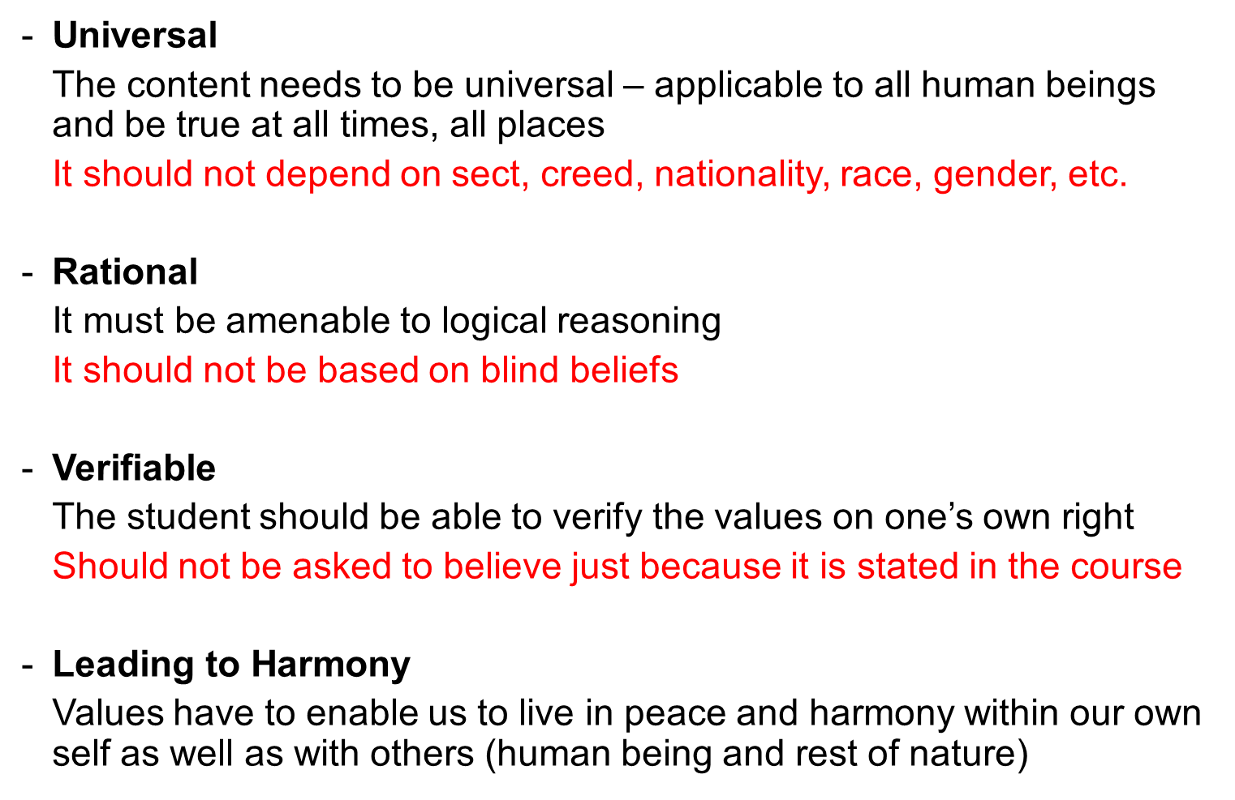
Sum Up
Need for Value Education
  To live with fulfilment, happiness, continuous happiness…
  it is essential to understand what is valuable for human being (human values)
  To understand human values, we need value education
Basic Guidelines for Value Education
Content of Value Education
All encompassing
Holistic
Process of Value Education
Self exploration, becoming Self-referential

Slide 25

Human Aspiration – As an Individual and Where are we today?
A. Living (Surviving)?
  Physical facility
B. Living with fulfilment?
  Physical facility
  Getting feelings from other
C. Living with continuous fulfilment?
  (called by different names such as bliss, peace, satisfaction, happiness, fulfilment, salvation, contentment, enlightenment, liberation, independence, self-actualisation, ecstasy, divinity,…)
  Having right understanding – in the Self (harmony in the Self,
  happiness)
  Having right feeling – in the Self (living with fulfilment in relationship with human being,
  mutual happiness)
  Physical facility – with rest of nature (living with mutual enrichment with rest of nature,
  mutual prosperity)

Slide 26
Human Aspiration – As a Society and Where are we today?
A. Families living together, in a relationship of mutual fulfillment
(common goal)
Society
B. Individuals living together, but not in relationship of mutual fulfillment
(differing goals)
Crowd
C. Individuals living separately, in opposition / struggle
(conflicting goals)
Battlefield

Slide 27
Key Points
Understanding Value Education

Slide 28
Need for Value Education
To live with fulfilment, happiness, continuous happiness…
it is essential to understand what is valuable for human being (human values)
To understand human values, we need value education

Slide 29
Guidelines for Value Education
Universal
The content needs to be universal – applicable to all human beings and be true at all times, all places
It should not depend on sect, creed, nationality, race, gender, etc.
Rational
It must be amenable to logical reasoning
It should not be based on blind beliefs
Verifiable
The student should be able to verify the values on one’s own right
Should not be asked to believe just because it is stated in the course
Leading to Harmony
Values have to enable us to live in peace and harmony within our own self as well as with others (human being and rest of nature)

Slide 30
Content of Value Education
Holistic, All Encompassing
Covers all levels of living:
    Individual (human being)
    Family
    Society
    Nature/Existence
Eg. As a Family, Society – we want Fearlessness / Trust
NOT fear (mistrust / opposition)
Covers all dimensions of being, as an Individual:
    Understanding/Realization
    Thought
    Behaviour
    Work/Participation in larger order
Eg. In Thought – we want to have clarity (a state of resolution, solution)
NOT confusion (a state of problem)

Slide 31
Process of Value Education
Whatever is said is a Proposal (Do not assume it to be true or false)
Verify it on Your Own Right – on the basis of our Natural Acceptance
It is a process of Dialogue
A dialogue between me and you, to start with
It soon becomes a dialogue within your own self
between what you are and what you really want to be (your natural acceptance)
The purpose of this course is to initiate/strengthen this internal dialogue,
to help you to be self-referential, self-confident
Is this process naturally acceptable to you?
Is the purpose of this course valuable for you?
More

Slide 32
FAQs for Lecture 1
Understanding Value Education

Slide 33
Question(s) 1: Need for Value Education Response
Response
There is a need for value education, but can we deliver it in today’s corrupt environment?
There is no space in the curriculum. Already the students are overburdened. So how do we justify this course?
What is the different between Value education and a course in moral science?
Is it desirable?
If yes, then we have to work for it, however unfavourable the environment may be; at whatever level there is a possibility (at least at the individual level… at the level of family to start with)
[What else?]

Slide 34

Check: What is generally done in the name of Value Education?
Understanding Value Education
(definite, universal, invariant…) (proposals,
Humane World-vision self-exploration,
knowing,
Self-discipline)
Natural Acceptance
Thinking Morals
(ideas, morals…) Beliefs
Doing Discipline, Instructions
(behaviour, work) (externally enforced
fear, incentive…)
Conduct is
Indefinite
Conduct is
Indefinite
Human Conduct
(Definite)

Slide 35
Question(s) 2: Need for Value Education Response
Why do we need to teach human values to students in school / college? Isn’t it the job of parents to inculcate values in their kids at home?
We have introduced UHV in higher education. But should not the UVH start early from childhood. Isn’t it too late to start teaching value education from college?
Due to cut-throat competition and lack of human consciousness in society, the focus of the students is on developing skill for a good pay package and not on values. How to bring their attention to values?
Responsibility of 1-parents, 2-teachers, 3-policy makers
It is essential, desirable but it is not happening so, where do we start?
Start with the parents…
But it should certainly be done in school…
Even in industry / MNCs preference is given to people who can relate to others, can work with others, are suitable for teamwork… cooperation… develop a conducive environment (expertise is easier to get)
They anyway want to lead a meaningful life – they are not just resources for the job
(after some time, they may accumulate some money, but they feel their life is not v meaningful)
Understanding the purpose and giving a direction to life it is required

Slide 36
Question(s) 2: Need for Value Education Response
Why do we need to teach human values to students in school / college? Isn’t it the job of parents to inculcate values in their kids at home?
We have introduced UHV in higher education. But should not the UVH start early from childhood. Isn’t it too late to start teaching value education from college?
Due to cut-throat competition and lack of human consciousness in society, the focus of the students is on developing skill for a good pay package and not on values. How to bring their attention to values?
The parents think that they are paying for education and hence it is the job of teachers. Teachers think that our task is to cover the syllabus and conduct exams, these things are the responsibility of parents. But ultimately the need is not met. And if it is not met in the family, it is our responsibility as teachers.
Response on next slide
Every student ultimately desires for a happy and prosperous life. We need to clarify this to the student through a process of dialogue.
We are not stopping the students from going for a higher package. We are only saying that it is not the complete program for life.

Slide 37
If we can start even now, Where to start from?
Where to start from: teachers or parents or policy makers?
At what level to start in education: primary or secondary or higher?
Its good to start value education right from elementary stage – children start learning values right from childhood in their homes from their parents…
So, its better to start from their parents.
But when you go to educate the parents, ultimately you have to work with grown ups.
Teachers
Society… policy makers
So, why not start with higher education!
Through higher education, you are directly able to address the future teachers, parents and policy makers.

Slide 38
Question(s) 3: Teaching of Human Values Response
Values can only be caught and not taught. Kindly comment.
How to make value education part of life rather than just being taught as a subject in formal education?
Implementation of human values in society holds the key. It is not just sufficient to teach the students for few semesters in colleges.

Slide 39
Question(s) 3: Teaching of Human Values Response
Values can only be caught and not taught. Kindly comment.
How to make value education part of life rather than just being taught as a subject in formal education?
Implementation of human values in society holds the key. It is not just sufficient to teach the students for few semesters in colleges. They may become misfits in society like this.
Response on next slide
Through self-exploration.
The content doesn’t have to be delivered as a prescription or a moral thing, rather as an essential requirement for continuity of happiness in life.
Agreed. But one needs to be clear what is there to be implemented.
Unless there is content to explore, what will one explore? Hence the classroom input is necessary.

Slide 40
Can Values be Taught?
One of the misconceptions has been that
“values cannot be taught, they are caught”
Of course, values are inspired and reinforced in institutions by people who are living models of human values
From the experiments in the last 15 years in mainstream education, it is clear that:
Human values can be taught!
    Youth, regardless of their background, find it interesting when it is shared as a proposal (rather than a set of instructions or do’s and don’ts).
    They are able to explore into the proposals, discover the values intrinsic in them
    Self-exploration is an effective means of self-evolution. There is significant perceptional transformation in those exploring seriously.
√

Slide 41
Question(s) 4: Teaching of Human Values Response
Shouldn’t the course on UHV be taught through practical exercises or short stories or case studies of great people, in place of classroom teaching? By classroom teaching, students will only mug up the content and reproduce in the examination. This will not bring any transformation in their life.
When a child is self-exploring, it is essential to give them proposals about basic, underlying principles
Help them to explore within, find out for themselves
Answer their questions, clarify
Provide a conducive environment
We do have practice sessions
Live examples
With that it is certainly a good idea to introduce stories… particularly when the child is imitating (as in primary education)

Slide 42
Question(s) 4: Teaching of Human Values Response
Shouldn’t the course on UHV be taught through practical exercises or short stories or case studies of great people, in place of classroom teaching? By classroom teaching, students will only mug up the content and reproduce in the examination. This will not bring any transformation in their life.
There are two parts to this process:
One, to grasp the proposal which states the basic principle about life.
Secondly, to verify and validate in one’s living.
And both are necessary.
So, we need to enable our teaching methodology to include both, and not leave the second part.
Practical exercises are already included.
We can of course include short stories or case studies of great people too. But we have to ensure that the content is grasped clearly. There is always a probability that the stories or memoirs of great men give some otherwise conclusions too.

Slide 43
Question(s) 5: Teaching of Human Values Response
Students already are not interested in studies. Many of them are sent forcibly for studies. And now we are adding one more course. Is it justifiable?
Are young students mature enough to sit through lectures like this and grasp these values?
That’s why we need to include such subjects which can help them relate better to education. Students lose interest in studies when they are not able to relate the studies to their life and happiness.
Yes. Students are very much in a position to explore if the content is proposed through a process of dialogue.

Slide 44
Question(s) 6: Teaching of Human Values Response
There is a vast generation gap between the teachers and students. How to teach this course creatively given this generation gap?
Today people only look for skills and not human values. Students have a feeling that if they care about such courses, they will be lagging professionally behind. Is it really possible to teach values in such a scenario?
How to manage the contradiction between focus on marks (for admission/placement) and importance of human values for life?
The generation gap may be there in terms of living, but there is no gap in Natural Acceptance. We have to help the students reflect on their natural acceptance.
Even in industries today, they are giving higher priority to teamwork. Further, we need to make it clear to the students that their basic aspiration is continuity of happiness and prosperity and not just the physical facility.
To begin with they may feel that there is contradiction but, when they start working on human values, it is found that they become sincere towards their academics

Slide 45
Question(s) 7: Basic Guidelines and Content of Value Education Response
What do we mean by universal here? Does it include all that has been said across the world?
We are saying that we do not have to assume anything as true or false, rather verify on one’s own right. Now how do we verify on our own right whether the earth revolves around the sun or the sun around the earth?
It includes the essence of all that has been said across the world for a happy and prosperous life, a happy and prosperous society.
Universal means applicable to every human being in all time and all place.
Essentially, we do need to verify what is the relationship of any activity (reality) with me, my life and happiness.
Having verified this, then in the process of of fulfillment of this relationship, we can get the necessary information through observation or from others, (e.g. about earth, sun and their rotation).

Slide 46
Additional Question Response
What is the difference between value and meaning
There are four aspects:
1-words → 2-meaning → 3-seeing the reality
→ 4-seeing the reality in completeness
Meaning – description of certain aspect of a reality…
Value – the role of a reality at different levels
Value is relative to the context, the larger order
Value of human being as an individual
Value of human being in family
Value of human being in society, etc.
Value of human being in its completeness
Value is one of the aspects of the reality, so a meaning may indicate one of these value

Slide 47
All participants requested to respond to the poll
So far only 50% have responded

Slide 48
Universal Human Values
Detailed discussion on universal human values is included in UHV-II FDP
Level | Participation (Values)
Individual | Happiness, peace, satisfaction and bliss
With other human beings | Trust, respect, affection, care, guidance, reverence, glory, gratitude, love + their expressed values
In societal order | Perseverance, bravery, generosity, kindness, beneficence, compassion
With rest of Nature | Nurturing, protection, right utilisation

Slide 49
About this Material and Effort on Universal Human Values
It has been prepared by UHV TEAM (uhv.org.in)
This work is licensed under CC0 1.0.
To view a copy of this license, please visit https://creativecommons.org/publicdomain/zero/1.0
We consider the efforts towards integrating value education in the present education system and moving towards holistic value-based education as a worthy mission for the wellbeing of all. In this spirit and to enable widespread usage, no royalty or fee is charged on this work.
We acknowledge, with deep gratitude, the existence, the entire nature and effort by generations of human beings for understanding and living by truth, love and compassion. The UHV effort is in continuation of this human tradition.
Guidelines for this effort and further efforts in this direction:
  1. Universal – the content must be universal – applicable to all human beings and be true at all times, in all places
  Should not depend on sect, creed, nationality, race, gender, etc.
  2. Rational – the content must be amenable to logical reasoning
  Should not be based on blind beliefs
  3. Verifiable – the student should be able to verify the values on his/her own right (on the basis of their natural acceptance and experiential validation)
  Should not be asked to believe just because it is stated in the course
  4. Leading to Harmony – the values have to enable us to live in peace and harmony within our own self as well as with others (human being and rest of nature)
  Should not lead to contradiction, differentiation, sectarianism, struggle, chaos, etc.

